Slide 1

Join a new era of enterprise management with SAP Business Suite

Slide 2








Meeting your challenges requires a new era of enterprise management
7
Systems of AI agents embedded into SAP applications and fueled by context-rich business data will make businesses unstoppable
AI
Systems of AI agents
Powered by accurate data from SAP and non-SAP sources, SAP’s unrivaled AI agents deliver
a unique advantage in cross-function collaboration, leveraging integrated data to enable smarter decisions and transformative outcomes
Data
Transformational insights
Applications
By centralizing unmatched data from SAP and non-SAP sources into a unified semantic layer, SAP unlocks insights, advanced analytics, and AI capabilities to empower businesses to drive intelligent growth and innovation
Transactional systems
For 50 years, SAP has connected and optimized core business processes with unparalleled applications and a technology platform, generating semantically-rich data that powers the world economy

Slide 3




Realizing our vision by bringing together applications, data, and AI
SAP brings all components together to lead the way into the next era of enterprise management
Joule
SAP
Business AI
as the new super orchestrator across end-to-end processes
30% efficiency increase
Unrivaled
AI
AI embedded in
business processes
Joule
SAP Foundation Model
SAP Knowledge Graph
Finance agents
Analytics agents
CX agents
Supply chain agents
HR agents
Spend agents
SAP Knowledge Graph
Unmatched
Data
100% accurate and secure business data
SAP Business
Data Cloud
Finance
data products
Supply chain
data products
HR
data products
Spend
data products
CX
data products
One semantical layer
Data products
360°
Semantically aligned SAP and non-SAP Data Products
Non-SAP
applications
Unparalleled Applications
Integrated Suite across SAP & non-SAP apps
SAP applications
Cloud ERP and
business applications
Financial
management
Supply chain
management
Human capital
management
Spend
management
Customer
experience
with structured and
unstructured data
powered by SAP Business Technology Platform

Slide 4
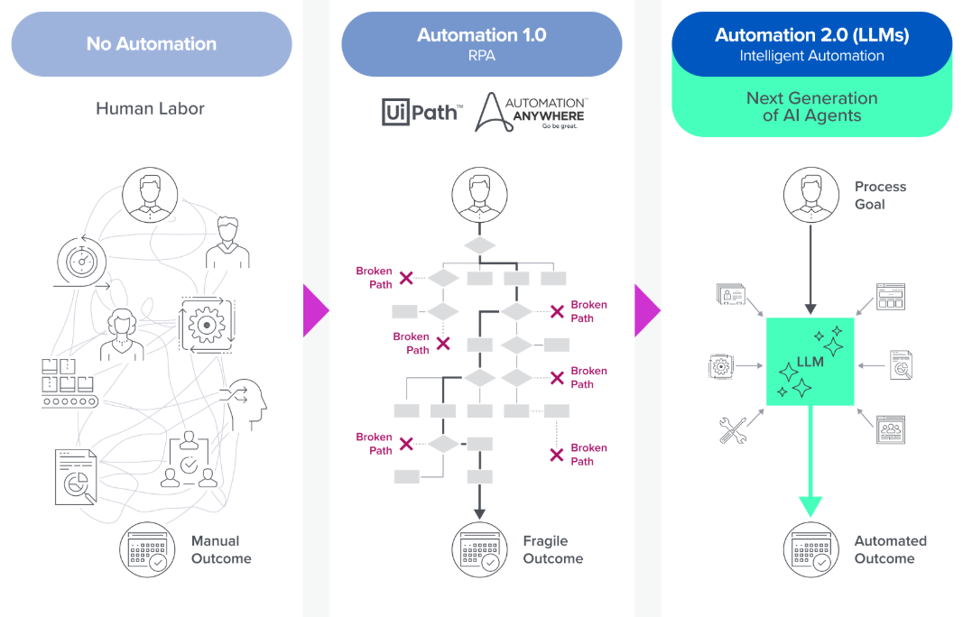
Agentic processes represent a next generation of automation
AI
Data
Applications
Source: Andreesen Horrowitz, RIP to RPA: The Rise of Intelligent Automation, published Nov, 13 2024

Slide 5

Systems of AI agents
AI
Data
Orchestrating across end-to-end processes and optimizing end-to-end planning
Applications
Joule
SAP
Business AI
as the new super orchestrator across end-to-end processes
30% efficiency increase
Joule
SAP Foundation Model
SAP Knowledge Graph
Finance agents
Analytics agents
CX agents
Supply chain agents
HR agents
Spend agents
Joule will orchestrate end-to-end processes
Joule will run complex analytical scenarios
Demand and supply planning including procurement negotiation
e.g., real-time financial steering and decision making
Predict customer demand
for new running shoe
Real-time procurement
demand
Workforce planning
Inflation
data
Sales
pipeline
Currency
data
Sales
agent
Supply chain
agent
Procurement
agent
Manage inventory
to ship on time
Select
best supplier
Inventory
status
Real-time
financial steering
GDP data
Example
Example

Slide 6

Unmatched Data with SAP Business Data Cloud
AI
Data
With SAP Business Data Cloud, your most valuable business data from every part of your business turns into
a semantically-rich data treasure that fuels unrivaled AI-powered value for your business
Applications
Business AI
Evolution of the Business Data Fabric journey which started in 2023 with SAP Datasphere and SAP Analytics Cloud powered by SAP HANA Cloud enhanced by SAP Databricks and SAP BW
Next pivotal step in SAP’s data strategy
on delivering out-of-the-box always-on data products following a harmonized data model to provide scalable access without duplication to reduce time to value
Adapting to the rapidly evolving needs
by adding more services supporting use cases such as generative AI, data products with rich semantics, and analytical insight apps
Insight Apps
Partner Ecosystem Apps
360° analytics
Extended planning
Business Data Fabric
Business semantics
Analytics and planning
BW modernization
Data engineering and ML/AI
Datasphere
Analytics Cloud
Business Warehouse
SAP Databricks*
Data products
Harmonized data models
SAP Apps
Hybrid
SaaS
Cloud-native
On-premises
Edge
Non-SAP Data
*SAP Databricks will be part of GA version

Slide 7

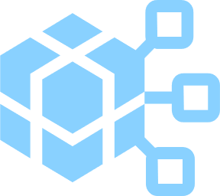


What is a data product?
Organize SAP data through data products
AI
Data
Applications
Business Data Sets
Master and transactional objects/entities, analytical data sets, config data, etc.
all semantically aligned
Well Described
via rich metadata descriptions and including semantics
Easily Consumable
Simple SaaS access from data modeling and BI tools, while fully integrated with data engineering tools
Discoverable
via an
SAP data product catalog

Slide 8


What are insight apps in SAP Business Data Cloud?
AI
Data
Applications
Insight apps are SaaS components of
SAP Business Data Cloud which expose the intelligent insights of their data to business users. The insight apps consume the underlying data based on SAP data products from SAP business applications.
  Utilize ready-to-run insights with out-of-the-box analytical models, dashboards and workflows for a variety of industry- and function-specific use cases
  Infused with SAP Business AI to help make timely decisions and respond to critical business signals as they happen
  Curated and managed by SAP, automatically connected to your data, ensuring accuracy and accelerating time to insights
Insights
Actions
Insight Apps
Insight App A
Insight App B
Infused with AI
Authoritative
data

Slide 9




Insight apps and data products leverage SAP’s deep knowledge of application data and metadata
AI
Data
Applications
SAP managed
Out-of-the-box SAP managed data products
delivered as part of
insight apps & data packages
S/4HANA PCE
Success Factors
Ariba
Concur
Data Products
Insight apps
…
Data integration & transformation
Zero copy
delta share
Custom managed
AI/ML
S/4HANA
ECC
Custom managed data products
for integration and extension of
insight apps & data packages
BW[4]
Third-party
Analytics

Slide 10
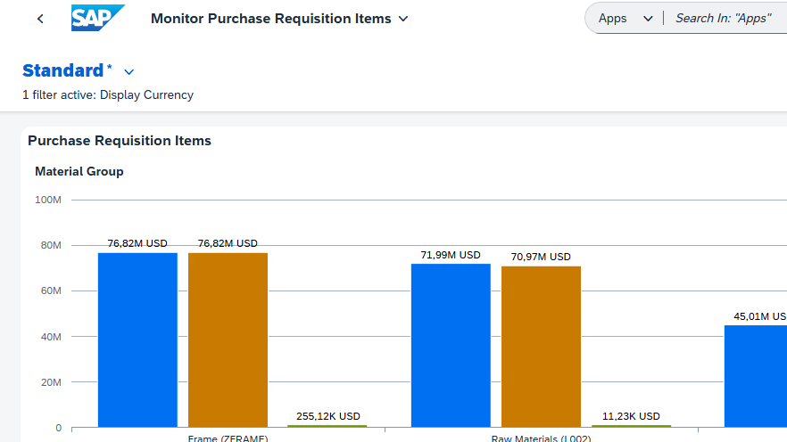
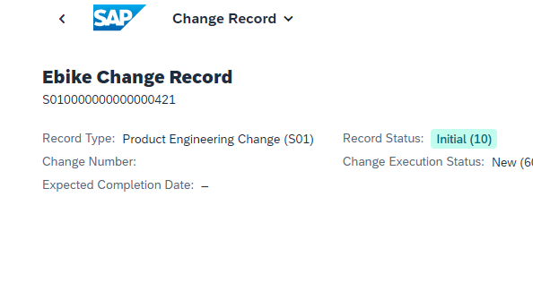
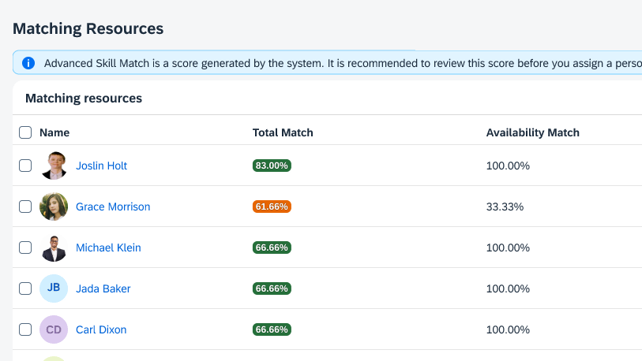
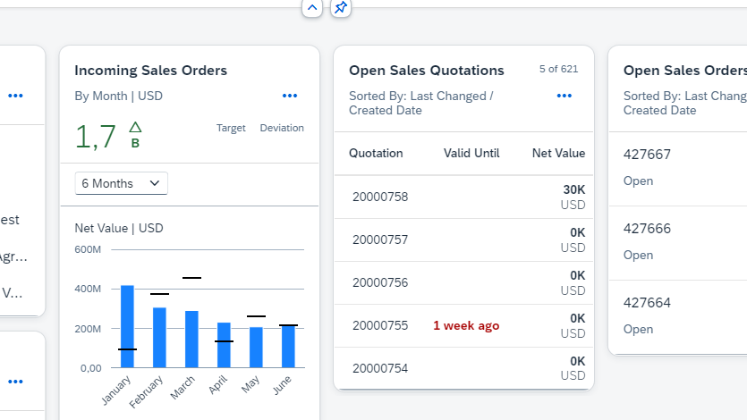
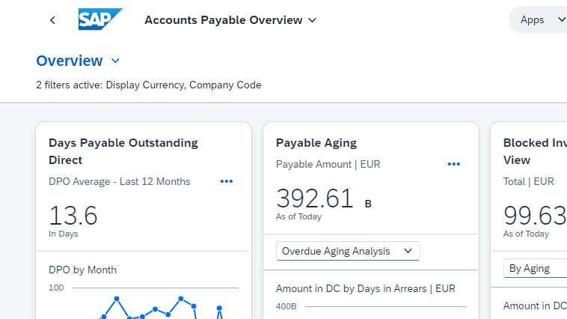
Unparalleled Applications
AI
Data
SAP’s applications and Business Technology Platform deliver comprehensive, connected
and tailored solutions to meet your unique needs.
Applications
Comprehensive
Power end-to-end business processes with the most comprehensive, integrated portfolio
of applications
Extensible and integrated
Easily connect and extend applications with generative AI powered development, automation, and integration solutions
Industry-specific
Tailored solutions for all industries,
built to meet unique business needs
Procure to pay
Design to operate
One suite
of applications with seamlessly
integrated business processes
Hire to retire
Lead to cash
Record to report
Business Technology Platform

Slide 11
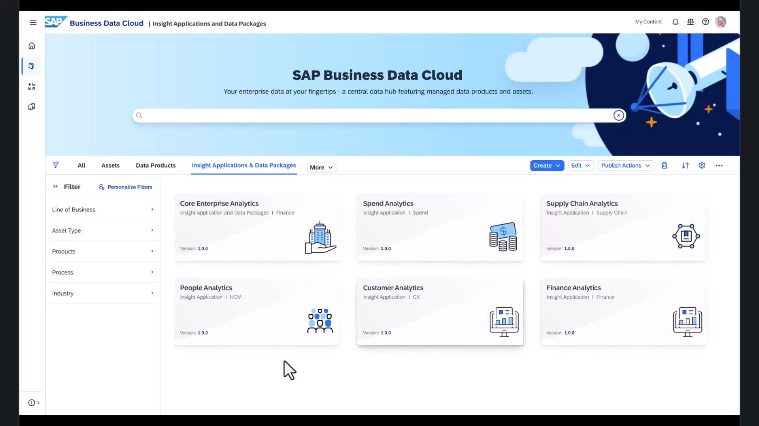
CONCEPTUAL

Slide 12
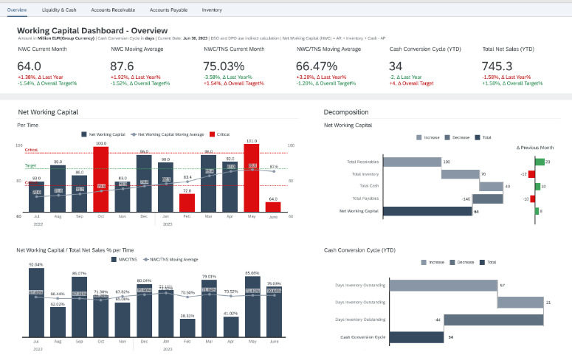
Working Capital – Gain a deep understanding of your operations
Insight Apps for Core Enterprise Analytics
Core Enterprise Analytics
Enabling companies to effectively make use of current assets and maintain sufficient cash flow to meet
short-term goals and obligations.
The insight app helps to answer:
  How has the working capital trended
  over the past few periods?
  What is the average payment period
  for accounts payable?
  Are there opportunities to negotiate better
  payment terms with suppliers?
  What is my days sales outstanding?

Slide 13
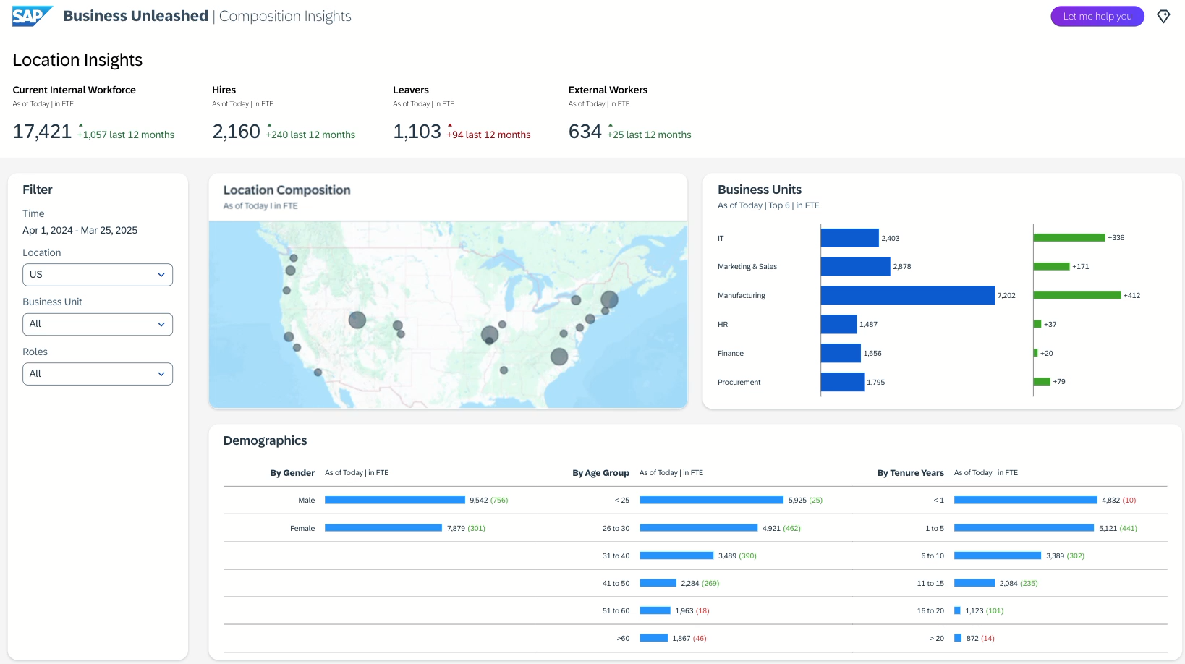
CONCEPTUAL

Slide 14
SAP Business Suite
The future of enterprise management

Slide 15



The future of enterprise management starts here
Two journeys, one destination: SAP Business Suite
Existing SAP ERP Customer
Modernize legacy system with SAP Business Suite
New SAP ERP Customer
Start fresh with SAP Business Suite

Slide 16
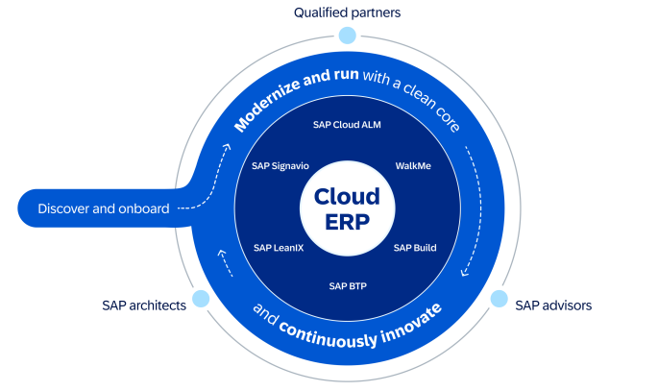
RISE with SAP Methodology
Transformation and continuous innovation
Transformation and continuous
innovation at your own pace
Standardized framework
Leveraging an integrated toolchain
Guided through an end-to-end engagement model

Slide 17







Solving individual challenges. Unleashing collective power.
SAP Business Suite delivers AI-powered value to every part of your business. But the real magic happens when everything comes together.
CFO
CPO
COO
CHRO
CRO
CIO
Leverage AI-powered financial forecasting to enhance planning and balance growth with profitability
Use AI-driven supplier insights
to optimize supplier selection and manage procurement risks
Harness AI-powered analytics to predict and respond to supply chain disruptions in
real time
Utilize AI-infused workforce insights to identify and address skills gaps
Apply AI-enabled personalization to customer interactions and predict sales opportunities
Deliver IT modernization and
AI-powered innovation with the
SAP Business Suite

Slide 18


Thank you!
© 2025 SAP SE or an SAP affiliate company. All rights reserved. See Legal Notice on www.sap.com/legal-notice for use terms, disclaimers, disclosures, or restrictions related to this material.

